Slide 1
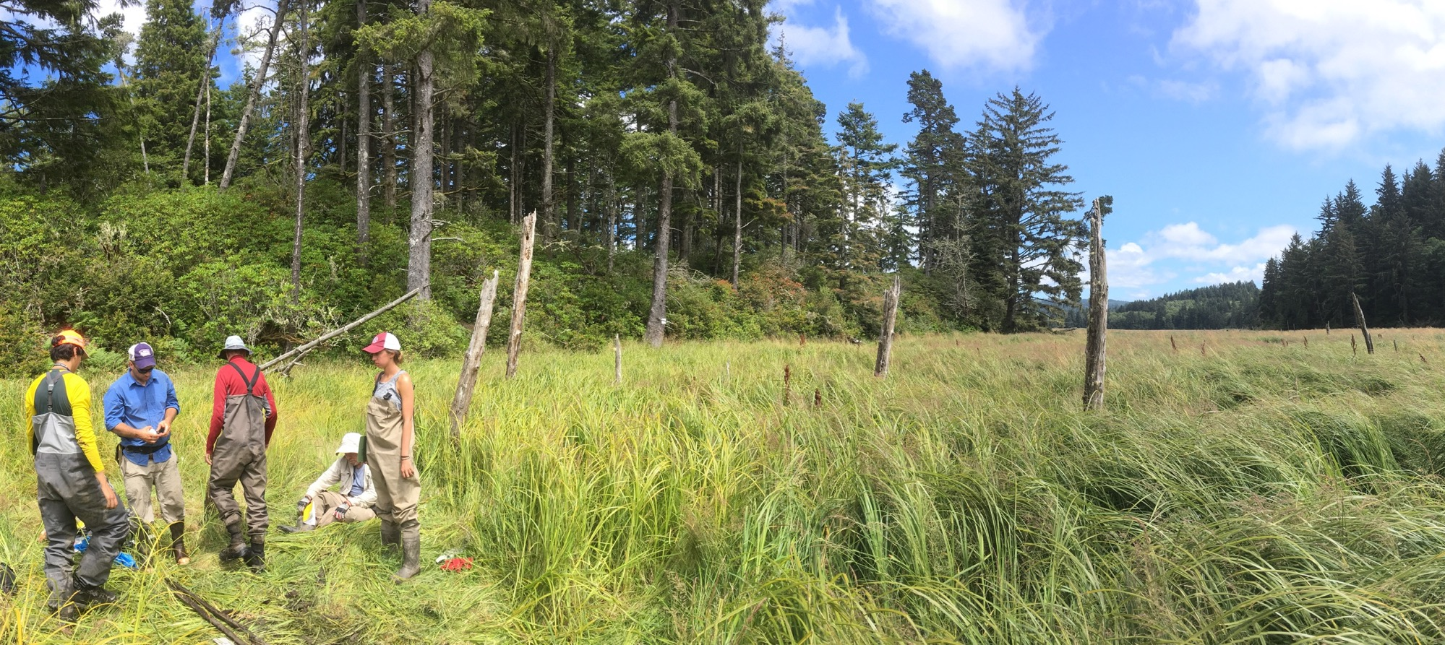

Cascadia Earthquake Recurrence and Fault Slip
Salmon River estuary, Oregon
Photo by Rob Witter
Pacific Northwest Earthquake Science Workshop
University of Washington, Seattle, WA
Tuesday, 5 November 2019
Rob Witter, PhD
USGS Research Geologist
rwitter@usgs.gov
Notes:
Good morning! I want to thank Erin Wirth and Joan Gomberg for inviting me to talk. They asked me to review what we know about ...
Earthquake Recurrence and Fault Slip on the Cascadia Megathrust

Slide 2
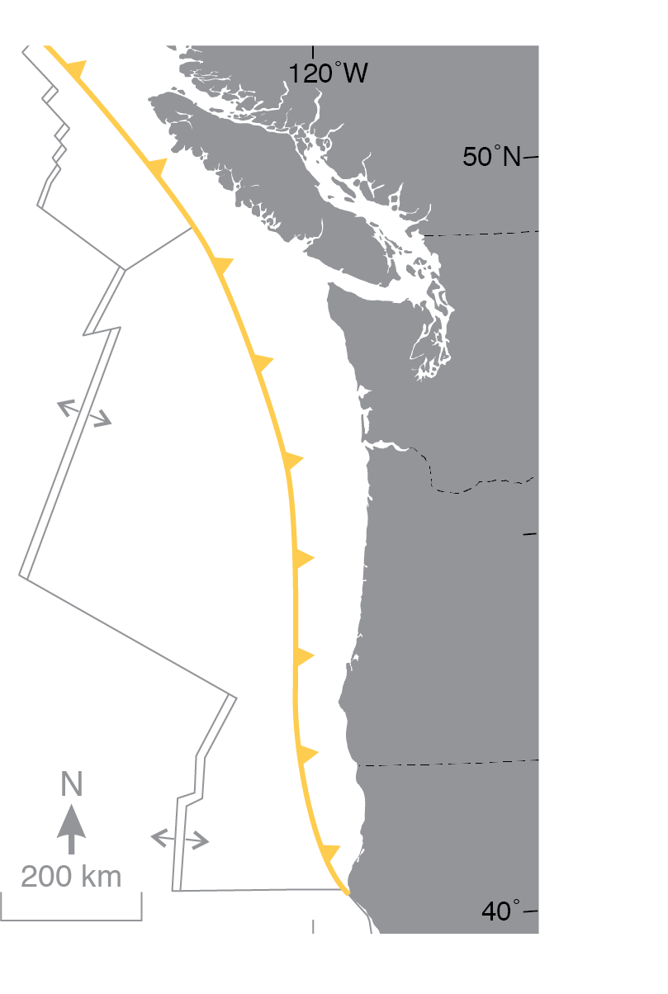
Talk outline
BC
Cascadia earthquake recurrence
• Great earthquake recurrence varies along strike
• Shorter recurrence times in the north / south
Slip models for the Cascadia megathrust
• Slip in the M9 1700 earthquake reached 19 m
• No single slip model uniquely resolves observations
• Range of variability of megathrust slip is unknown
Concluding remarks
• Advancing Cascadia science requires consilience:
convergence of evidence leads to strong conclusions
WA
30-37 mm/yr
OR
CA
Pacific Northwest Earthquake Science Workshop
5 November 2019
Notes:
In this talk I will review findings that provide estimates of Cascadia earthquake recurrence intervals. Abundant evidence support a ~500 yr average recurrence interval for great Cascadia earthquakes, but interevent times may vary from as little as a few decades to more than 900 years. Emerging evidence implies that shorter earthquake recurrence times occur in northern and southern Cascadia.
Next I will review slip models for the Cascadia megathrust: here I felt that a retrospective look would be helpful—I will review a convergence of evidence that led to a strong conclusion that the 1700 Cascadia earthquake was a full margin rupture near M9 and involved 19 m of slip on the megathrust. However, a variety of slip models exist and there is not one unique solution; moreover, the range of slip distributions possible for a Cascadia event is unknown.
Finally, I will conclude with a few remarks about mitigating seismic and tsunami risk: it is my view that advancing Cascadia science will require consilience: the notion that convergence of evidence leads to strong conclusions, particularly where geophysical models and geological observations converge. Reducing risk will require effective communication among scientists, stakeholders, and decision makers.

Slide 3
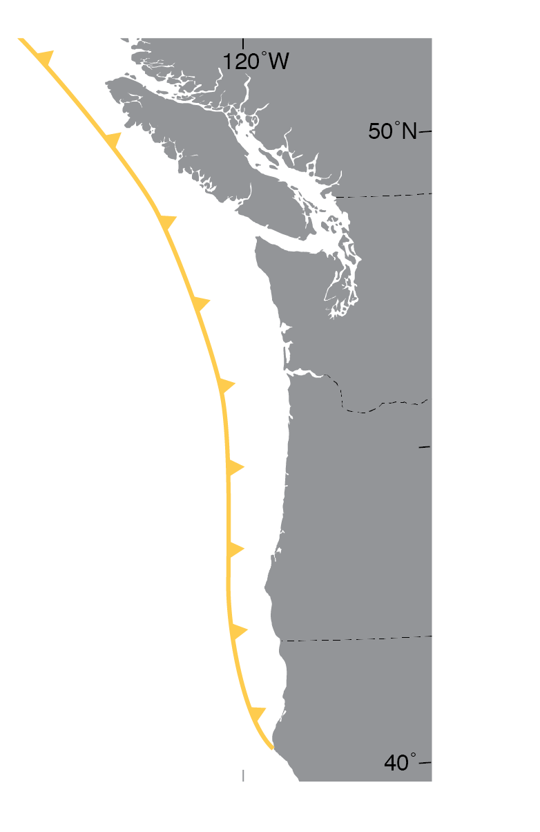
Cascadia earthquake recurrence
Evidence comes from many different observations
- Coastal subsidence
- Tsunami deposits
- Shaking impacts
Atwater et al., 2005
Adams, 1990
Atwater et al., 2005
Pacific Northwest Earthquake Science Workshop
5 November 2019
Notes:
Geological evidence used to estimate Cascadia earthquake recurrence intervals comes from many different observations, including... The different settings and depositional environments where these observations occur have different thresholds that control the formation and preservation of evidence. In each case, the evidence records different impacts or processes that respond to an earthquake.
Individually, each line of evidence tells an incomplete story, but taking different types of evidence together may clarify the picture.

Slide 4
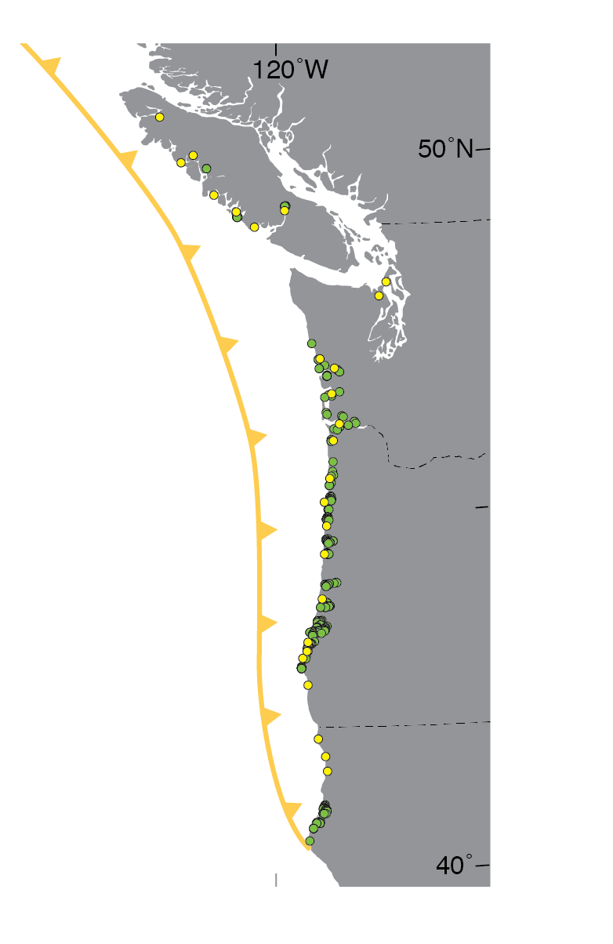
Cascadia earthquake recurrence
Onland record
Northern Cascadia sites [3-6 earthquakes]
>300 yr average recurrence interval
Length of record spans <3,000 yrs
Southwestern Washington estuaries [7-9]
500-530 yr average over <5,000 yrs
Northern and central Oregon coast [4-6]
500-600 yr average over <3,500 yrs
Southern Oregon coast [17]
390-500 yr average over <7,000 yrs
Northern California coast [4-6]
500-600 yr average over <3,500 yrs
Tsunami deposits data compiled by Peters et al., 2003
Subsidence data compiled by Leonard et al., 2010
Pacific Northwest Earthquake Science Workshop
5 November 2019
Notes:
The onland record includes sites spanning the length of the Cascadia margin.
The number of earthquakes recorded varies from site to site...
...and average recurrence intervals vary along the coast, in part, because the lengths of the geologic record differ between sites.
Evidence from one site to the next varies in type and quality, and most onland records are probably incomplete for earthquakes M>8 and probably don’t record earthquakes less than M8.

Slide 5
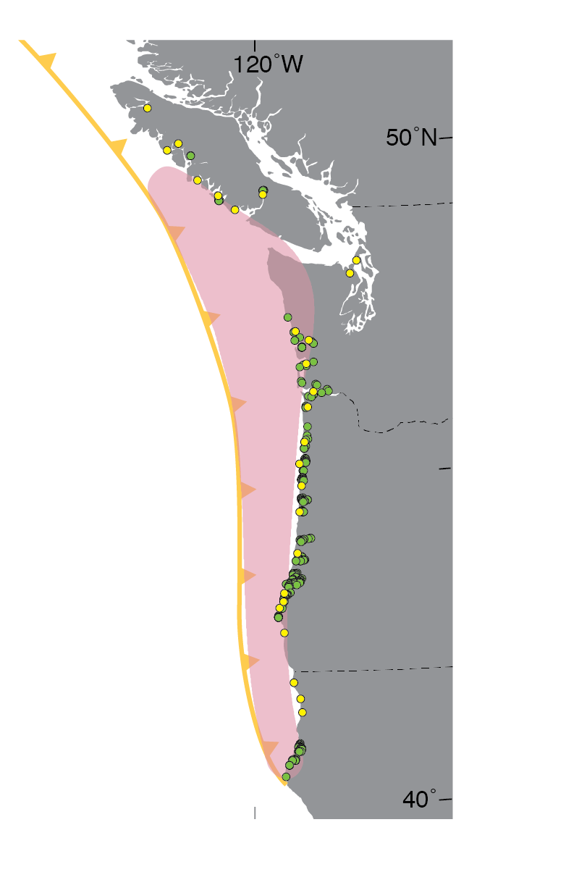
Cascadia earthquake recurrence
Onland record
Inferred
Northern Cascadia sites [3-6 earthquakes]
>300 yr average recurrence interval
Length of record spans <3,000 yrs
Southwestern Washington estuaries [7-9]
500-530 yr average over <5,000 yrs
Northern and central Oregon coast [4-6]
500-600 yr average over <3,500 yrs
Southern Oregon coast [17]
400-500 yr average over <7,000 yrs
Northern California coast [4-6]
500-600 yr average over <3,500 yrs
rupture
Tsunami deposits data compiled by Peters et al., 2003
Subsidence data compiled by Leonard et al., 2010
extent
Pacific Northwest Earthquake Science Workshop
Notes:
However, with the exception of the most recent great earthquake in 1700, uncertainties in radiocarbon-derived earthquake chronologies from coastal studies cannot differentiate between full-margin ruptures...

Slide 6
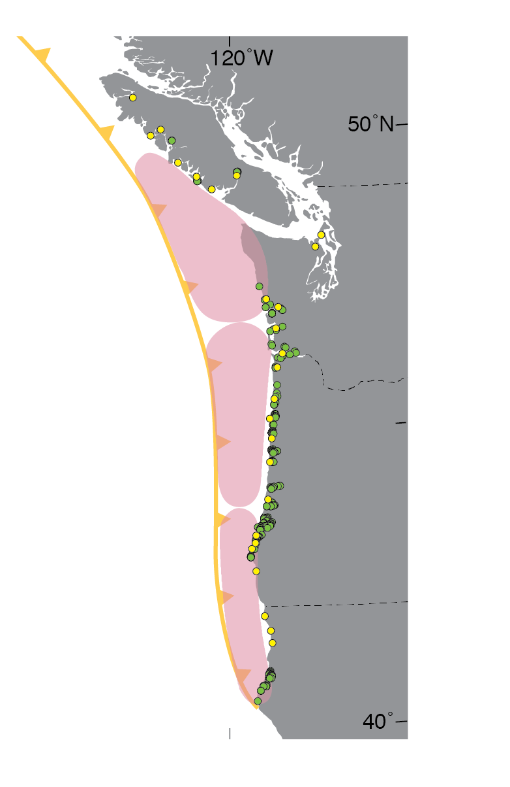
Cascadia earthquake recurrence
Onland record
Northern Cascadia sites [3-6 earthquakes]
>300 yr average recurrence interval
Length of record spans <3,000 yrs
Southwestern Washington estuaries [7-9]
500-530 yr average over <5,000 yrs
Northern and central Oregon coast [4-6]
500-600 yr average over <3,500 yrs
Southern Oregon coast [17]
400-500 yr average over <7,000 yrs
Northern California coast [4-6]
500-600 yr average over <3,500 yrs
Tsunami deposits data compiled by Peters et al., 2003
Subsidence data compiled by Leonard et al., 2010
Pacific Northwest Earthquake Science Workshop
Notes:
...and serial ruptures of the megathrust separated by years or decades in time.

Slide 7
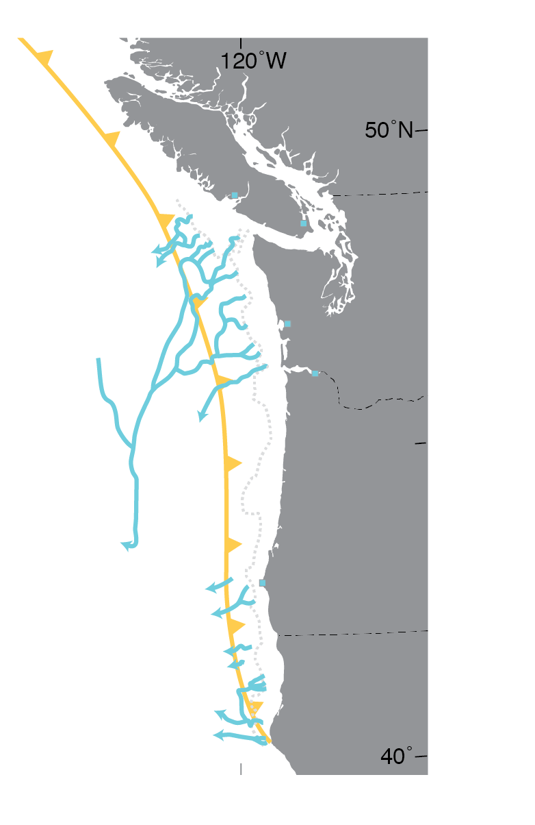
Cascadia turbidites
Cascadia Channel
core M9907-25PC
19 Holocene turbidites in the north
T1
T5
T14
T3
T15
T2
T8
T11
T16
T6
T12
Cascadia
Channel
T4
T9
T17
T17a
T13
T10
T18
T7
Adams, 1990
Pacific Northwest Earthquake Science Workshop
Goldfinger et al., 2012
Notes:
Offshore, 19 Holocene turbidites, rhythmic beds of sand and silt beneath the floors of submarine canyons and abyssal fans, are recorded in cores along the entire Cascadia margin.
This core is from Cascadia Channel.

Slide 8
Cascadia turbidites
19 Holocene turbidites in the north
>40 Holocene turbidites in the south
Hydrate
Ridge
Goldfinger et al., 2012
Rogue
Pacific Northwest Earthquake Science Workshop
5 November 2019
Notes:
Goldfinger and colleagues have extended the record to the Pleistocene / Holocene boundary and show that turbidites offshore southern Cascadia include the 19 deposits recognized in northern cores plus an additional 22 thinner, mud turbidites.
These examples from Hydrate Ridge and Rogue Channel show gamma density (left) and magnetic susceptibility (right) logs that characterize the physical properties of the sediment and are proxies for grain size.
Patterns in the wiggle traces of core logs supported by radiocarbon-based age-depth models have been interpreted as fingerprints that justify turbidite correlations between cores separated by 250 km.
Justifications for the correlations are a topic of vigorous debate, but in my view no new evidence has come to light that refutes Goldfinger’s hypothesis.

Slide 9
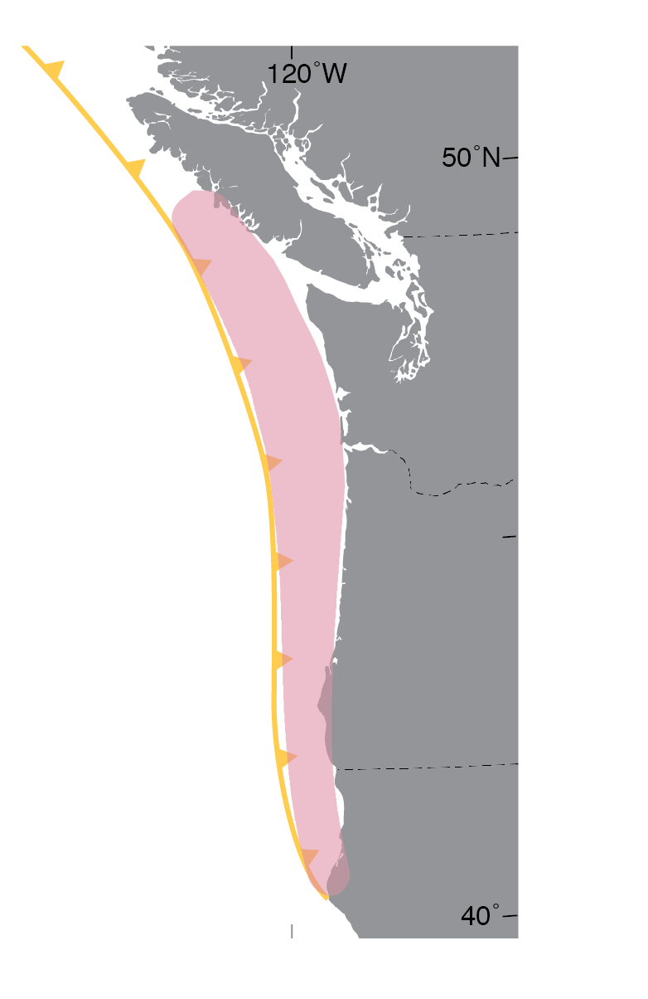
Turbidite recurrence varies
  Full-rip nine
  19 turbidites
  480-505 yr average recurrence interval
  ~10,000 yrs length of record
Barkley
Inferred
Juan
de Fuca
Astoria
NB
Segment A
Hydrate
Ridge
rupture
HB
Goldfinger et al., 2012; 2017
Rogue
CB
extent
?
Pacific Northwest Earthquake Science Workshop
5 November 2019
Notes:
In Goldfinger’s interpretation, variations in the number of turbidites along strike imply that past great earthquakes have ruptured different segments of the plate boundary (inferred rupture barriers are shown by dotted lines).
19 turbidites observed in cores from Barkley Canyon to the Rogue Channel, correlated by wiggle traces, suggest full-length or nearly full-length ruptures with average recurrence intervals of about 500 yrs.

Slide 10
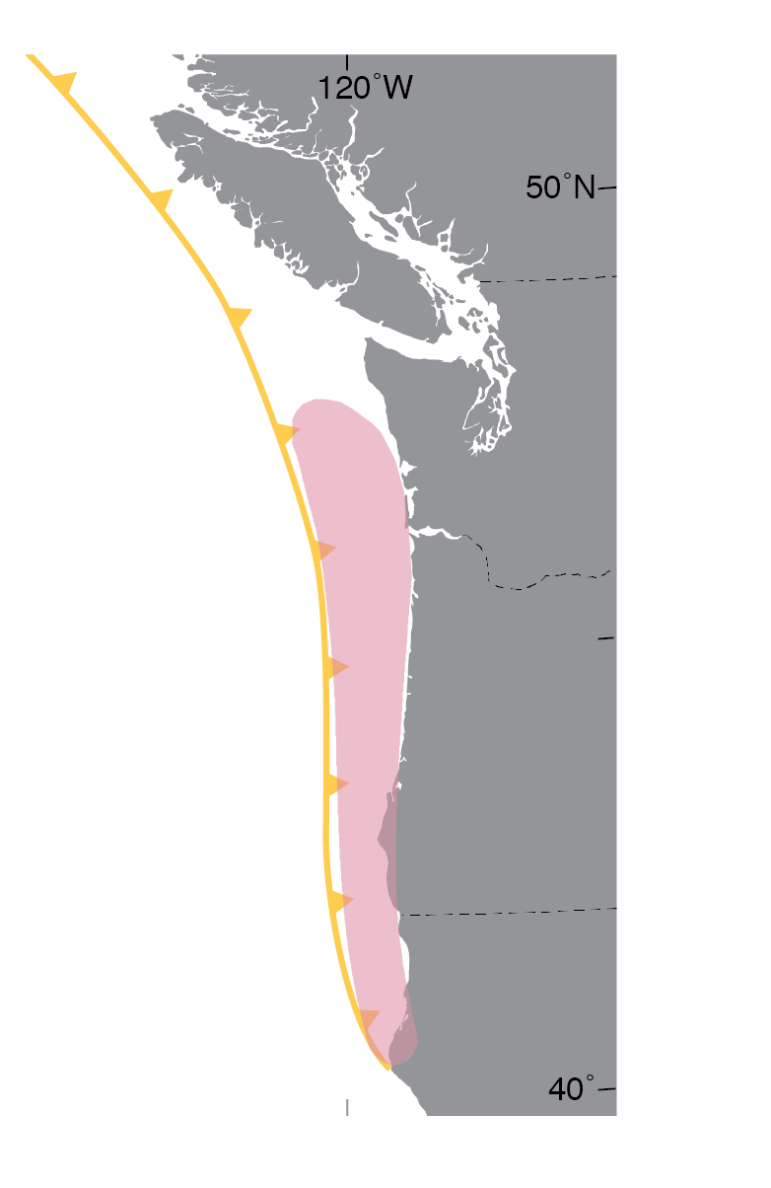
Variable rupture behavior
Barkley
  Northern Washington to Rogue Channel
  22 turbidites
  ~435 yr average recurrence interval
  ~10,000 yrs length of record
Juan
de Fuca
Astoria
NB
Hydrate
Ridge
Segment B
HB
Goldfinger et al., 2012; 2017
Rogue
CB
?
Pacific Northwest Earthquake Science Workshop
5 November 2019
Notes:
Cores offshore Washington and south to Rogue Channel include 22 turbidites with an average recurrence interval of ~435 yrs.

Slide 11
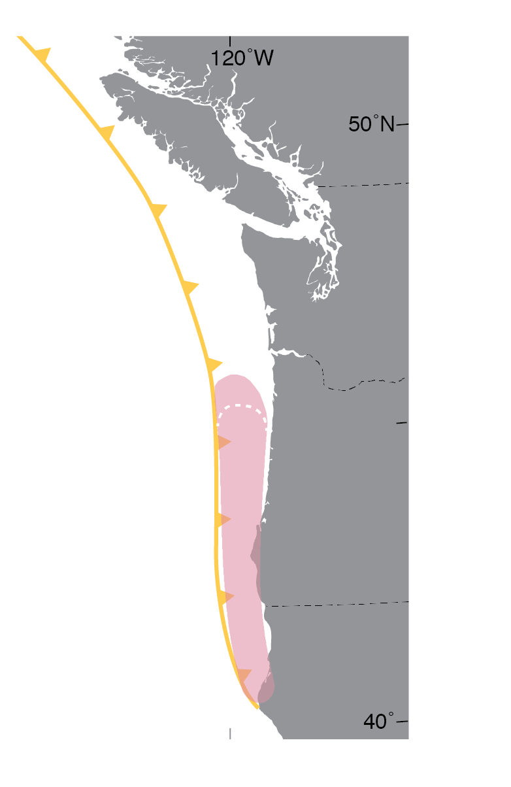
Variable rupture behavior
Barkley
Goldfinger et al., 2012; 2017
Juan
de Fuca
Astoria
NB
  Northern Oregon to Rogue Channel
  31 turbidites
  320-340 yr average recurrence interval
  ~10,000 yrs length of record
Hydrate
Ridge
HB
Segment C
Rogue
CB
?
Pacific Northwest Earthquake Science Workshop
5 November 2019
Notes:
31 turbidites that correlate between cores offshore Oregon and Rogue Channel imply an average recurrence interval of 320-340 yrs.

Slide 12
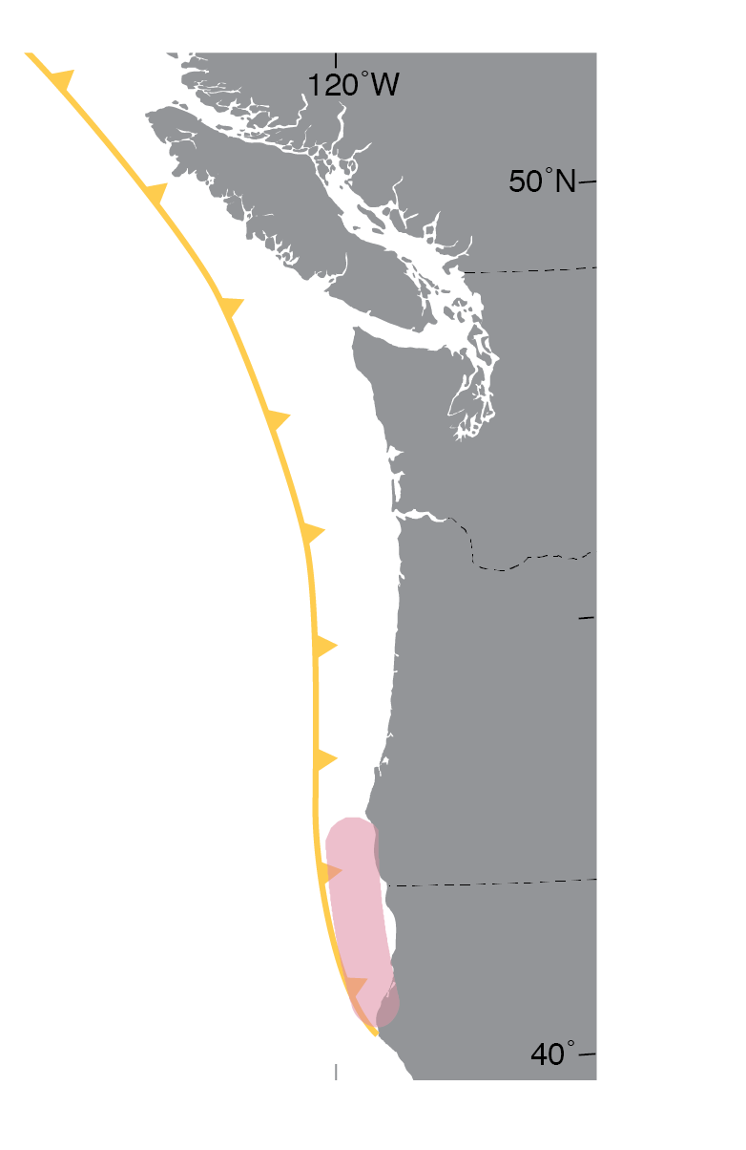

Mud turbidite T2a, Rogue Apron
Full-rip nine
  19 turbidites
  500-530 yr average recurrence interval
Barkley
Juan
de Fuca
Astoria
NB
Hydrate
Ridge
HB
Goldfinger and others, 2012; 2017
  Coquille Bank to Cape Mendocino
  >40 turbidites
  <220 yr average recurrence interval
  ~10,000 yrs length of record
Rogue
CB
Segment D
?
Notes:
And along the southern margin, >40 turbidites that Goldfinger interprets to have an earthquake origin, including mud turbidites like T2a shown in the computed tomographic density (CT) image at left, have the shortest recurrence intervals averaging <220 yrs.

Slide 13

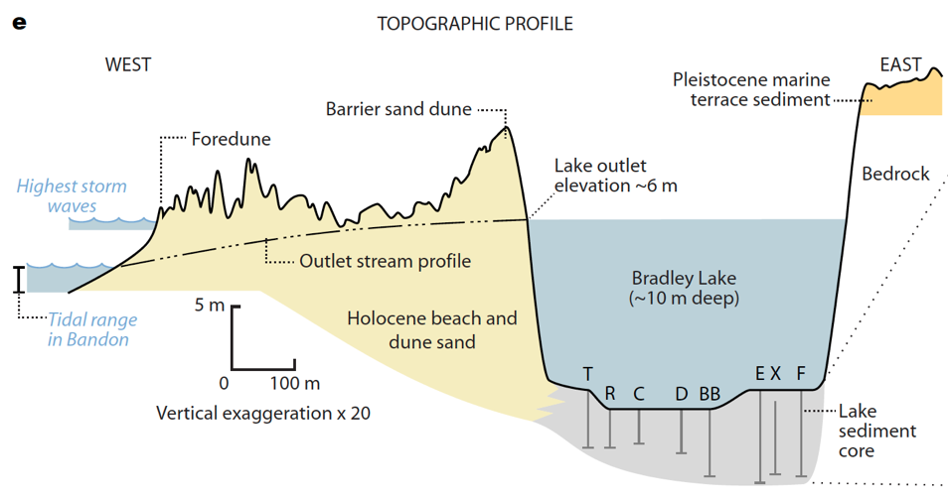
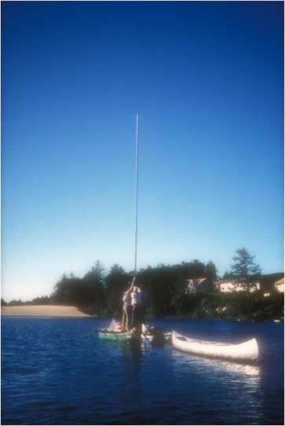
Comparing offshore and onshore records of recurrence
4,600-yr record of tsunami inundation
Bradley
Lake
Kelsey et al., 2005; Witter et al., 2012
Pacific Northwest Earthquake Science Workshop
5 November 2019
Notes:
Many are skeptical about the origin of mud turbidites in southern Cascadia. Until others propose alternative triggers supported by evidence, Goldfinger’s interpretation stands as a reasonable hypothesis. But what does the onshore data say?
The longest record of Cascadia tsunamis resides in Bradley Lake, a unique site in southern Oregon that was flooded by 12 tsunamis in the past 4,600 years.
Bradley Lake is a little over 0.5 km from the Pacific Ocean, elevation of the lake’s outlet is about 6 m above sea level, at its deepest part the lake floor is 10 m below the surface.

Slide 14
Bradley
Lake
Kelsey et al., 2005; Nelson et al., 2006
Notes:
This figure shows a stratigraphic cross section plotting eight sediment cores taken from the central axis of Bradley Lake that record 12 Cascadia tsunamis in the past 4,600 years (shown in yellow), which amount to a recurrence interval of about 390 years.
The photo at right shows the sequence of deposits related to tsunami inundation in the lake about 1,000 years ago.
At the base of the sand layer, the eroded lower contact truncates laminated lake mud.
The sand layer includes clasts ripped up from the bottom of the lake and consists of at least two fining upward pulses.

Slide 15
Converging evidence
Recurrence in southern Oregon
- Offshore: 320–340 years
- Bradley Lake: ~390 years
Hydrate
Ridge
Alsea Bay
Bradley
Lake
Rogue
Witter et al., 2012; Priest et al., 2018
Notes:
A complicated diagram to illustrate a simple point: paleoseismic records onshore are consistent with shorter earthquake recurrence intervals in southern Cascadia implied by the turbidite record offshore.

Slide 16
Converging evidence
Recurrence in southern Oregon
- Offshore: 320–340 years
- Bradley Lake: ~390 years
Both datasets support shorter recurrence intervals in southern Cascadia
Hydrate
Ridge
Alsea Bay
Bradley
Lake
Rogue
Witter et al., 2012; Priest et al., 2018
Notes:
A complicated diagram to illustrate a simple point: paleoseismic records onshore are consistent with shorter earthquake recurrence intervals in southern Cascadia implied by the turbidite record offshore.
But to what degree the combined datasets reflect longer or shorter ruptures on the megathrust is uncertain. Much more work is necessary to decipher these details.

Slide 17
Discovery Bay, Washington
2,500-yr record of tsunami inundation
- 9 tsunami deposits
- Tidal marsh traps
tsunami deposits
- Bed 2 precisely
dated
Discovery
Bay
Garrison-Laney and Miller, 2017
Pacific Northwest Earthquake Science Workshop
5 November 2019
Notes:
Another example of a study where evidence appears to be converging is at Discovery Bay, Washington. The site is a tidal marsh in Discovery Bay that has trapped and preserved nine tsunami deposits from the past 2500 years thought to record Cascadia and non-Cascadia earthquake sources. Precise dating of Bed 2 shows how new approaches in sampling material for radiocarbon dating and age modeling can possibly clarify details of past Cascadia earthquakes.

Slide 18
Discovery Bay, Washington
More precise age obtained for Bed 2
Discovery
Bay
Garrison-Laney and Miller, 2017
Pacific Northwest Earthquake Science Workshop
5 November 2019
Notes:
The study provides a good example of methods for age dating that might improve upon the limitations of the current earthquake chronology. Here, Carrie selected samples of leaf bases from fossil Triglochin maritima, intertidal plants easily identified in outcrop. Using modeling tools in the radiocarbon calibration program OxCal, the stratigraphic ordering of plants that grew before and after Bed 2 was deposited results in a relatively narrow modeled age ranging from 560–630 cal yr BP.

Slide 19
Bed 2
Seattle Fault Zone
Cascadia event W
Cascadia event ?
1700 earthquake
Garrison-Laney and Miller, 2017
Pacific Northwest Earthquake Science Workshop
5 November 2019
Notes:
Placed in the context of other earthquake and tsunami records in the region increases confidence in the interpretation that the immediate predecessor to the 1700 Cascadia earthquake may have been a shorter rupture in northern Cascadia that did not cause substantial coastal subsidence in southwestern Washington.

Slide 20
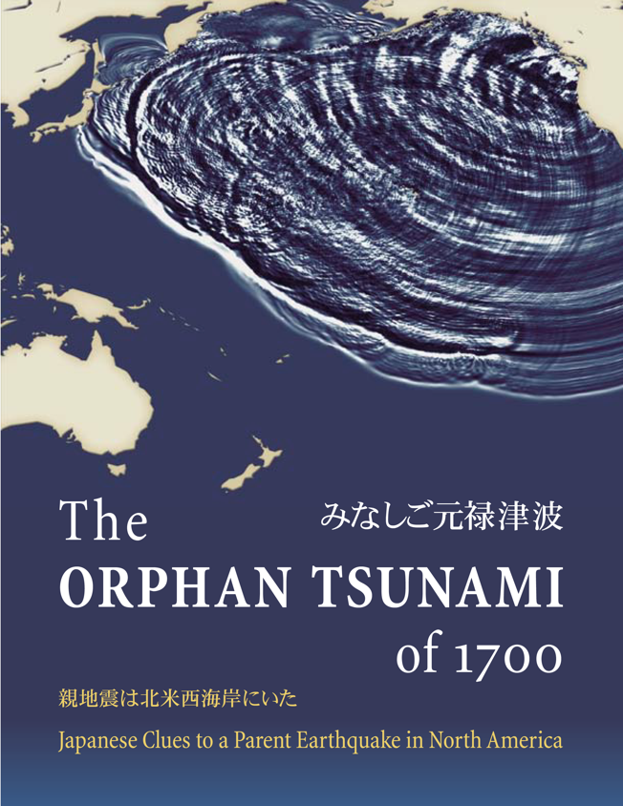
A convergence of evidence . . .
- Accounts from Japan of an orphan tsunami
- Tsunami modeling
- Paleoseismology
. . . led to a consensus on time, size, and slip
Satake et al., 1996; 2003; Atwater et al., 2005
Pacific Northwest Earthquake Science Workshop
5 November 2019
Notes:
For this audience I felt it might help to present a retrospective view when a convergence of evidence led to a consensus on time, size, and slip for the great 1700 Cascadia earthquake. This is an example of how consilience led to breakthrough advances in Cascadia earthquake science. Many of us are familiar with the work of Satake and others detail how accounts of an orphan tsunami in Japan, combined with tsunami modeling and paleoseismology, led to a strong conclusion that the most recent Cascadia earthquake occurred on January 26th, 1700, probably involved rupture of the full length of the subduction zone, and as much as 19 m of slip on the megathrust.

Slide 21
1700 Cascadia slip models
Long-Narrow M_{w} 9.0
- 1100 km rupture length
- 48 km full-slip zone width
- 19 m slip, full-slip zone
- 4.6 x 10²² N m seismic moment
DOWN
UP
Profile
Satake et al., 2003
Pacific Northwest Earthquake Science Workshop
5 November 2019
Notes:
The breakthrough came from the work of Kenji Satake and colleagues who compared many different slip models used to simulate tsunamis that matched tsunami wave heights observed in Japan in 1700. In the next several slides I’ll show four of the slip models that Satake considered, simulate tsunamis that match observations in Japan. The preferred model was selected because it also was consistent with paleoseismological observations along the Cascadia coast.
Each scenario is developed using a 3D elastic dislocation model with a full slip zone and partial slip zone shown in this diagram.
The first slip model shown here is the long narrow, simulating a M9 rupture along the entire 1100 km length; the full–slip zone (shown in inset) was 48 km wide and accommodated 19 m of slip; slip linearly decreased to zero down dip in a partial-slip zone, here. The model predicts vertical displacement shown in this profile at Greys Harbor in WA; 4-m of uplift offshore is shown in orangey-yellow, and 1-2 m of subsidence occurs inland and along the coast, shown in blue. This model is consistent with evidence of coastal subsidence in 1700, including 0.5-1.5 m of subsidence inferred from microfossils at Greys Harbor (green rectangle).

Slide 22
1700 Cascadia slip models
Long-Wide M_{w} 9.2
- 1100 km rupture
- 100 km full-slip zone width
- 21 m slip, full-slip zone
- 9.2 x 10²² N m seismic moment
Profile
Satake et al., 2003
Pacific Northwest Earthquake Science Workshop
5 November 2019
Notes:
Here’s where the models began to diverge from observations. The Long-Wide model distributed 21 m of slip on a 100-km wide full-slip zone, more than twice the width of the other models. Although this model can generate tsunami heights consistent with observations in Japan, it predicts uplift along the coast in southwestern Washington, which is inconsistent with evidence for coastal subsidence at Copalis, Washington and Netarts Bay, Oregon.

Slide 23
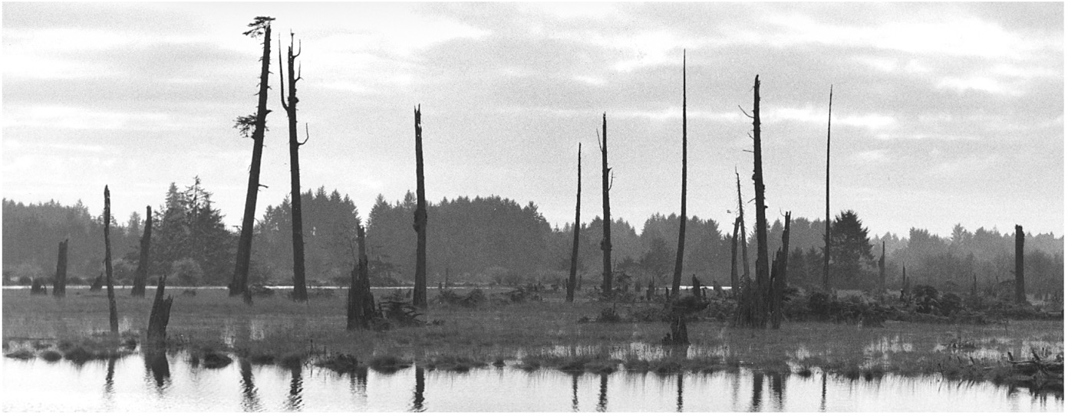
1700 Cascadia slip models
Long-Wide M_{w} 9.2
Predicted uplift conflicts with observations
Profile
Copalis River, high tide, December 1997
Atwater et al., 2005
Pacific Northwest Earthquake Science Workshop
5 November 2019
Notes:
Ghostly remains of trees subsided and killed by the 1700 Cascadia earthquake, Copalis River, high tide, December 1997.

Slide 24
1700 Cascadia slip models
Short-North M_{w} 9.0
- 670 km rupture
- 56 km full-slip zone width
- 39 m slip, full-slip zone
- 6.7 x 10²² N m seismic moment
Profile
Satake et al., 2003
Pacific Northwest Earthquake Science Workshop
5 November 2019
Notes:
Satake and others also considered shorter slip models to explain the orphan tsunami in Japan. In this case the model consisted of a 670 km long rupture from VI to northern OR with 39 m slip on the full-slip zone. In this case the model predicts much greater subsidence along the coast than that observed in southwestern Washington.

Slide 25
1700 Cascadia slip models
Long-Narrow M_{w} 9.0
- 1100 km rupture length
- 48 km full-slip zone width
- 19 m slip, full-slip zone
- 4.6 x 10²² N m seismic moment
Profile
Satake et al., 2003
Pacific Northwest Earthquake Science Workshop
5 November 2019
Notes:
The convergence of tsunami modeling and observations led Satake et al to select the Long-Narrow scenario as the preferred slip model for the 1700 Cascadia earthquake, which supports the current consensus that the most recent earthquake was a full-rip M9.

Slide 26
Heterogeneous slip model
Patches of high slip in 1700
- Constrained by precise micro-
fossil-based subsidence estimates
- Depicts areas of high slip
separated by areas of low slip
- Identifies possible rupture
barriers
Wang et al., 2013
Pacific Northwest Earthquake Science Workshop
Notes:
Since then new approaches to model the 1700 Cascadia earthquake involve heterogeneous slip models. In this model by Wang et al. slip patches taper slip to zero both up and down dip and in the fault parallel direction. This heterogeneous slip model is constrained by precise microfossil-based estimates of coastal subsidence plotted here. The model simulates patches of slip exceeding 16 m separated by areas of little to no slip. The low slip areas are constrained by observations of little subsidence during the 1700 earthquake from observations along the coast. Areas of low slip may correspond to possible rupture barriers, like subducting seamounts or crustal structure in the North American plate, which have been proposed along the margin.

Slide 27
M9 slip models also fit subsidence in 1700
Subevents influence coastal subsidence
- Analogs from Chile and
Japan
- Background slip radiates
low-frequency energy
- Subevents radiate high-
frequency energy
Wirth and Frankel, 2019
Pacific Northwest Earthquake Science Workshop
5 November 2019
Notes:
Observations of coastal subsidence during the 1700 earthquake also can be fit to kinematic slip models that include high-dynamic stress-drop or “subevents,” in the deeper part of the rupture. Similar patches of slip that radiate high frequency energy and produce strong ground motions were observed during the 2010 Maule, Chile, and 2011 Tohoku, Japan earthquakes. In the far right panel heterogeneous slip that generates low-frequency energy exceeds 35 m near the trench. The rectangular holes in the slip model are filled by hypothetical subevents with slip up to 10 m in patches equivalent to M 8-8.2 earthquakes. The panel on the left shows that the slip model fits estimates of coastal subsidence quite well.

Slide 28
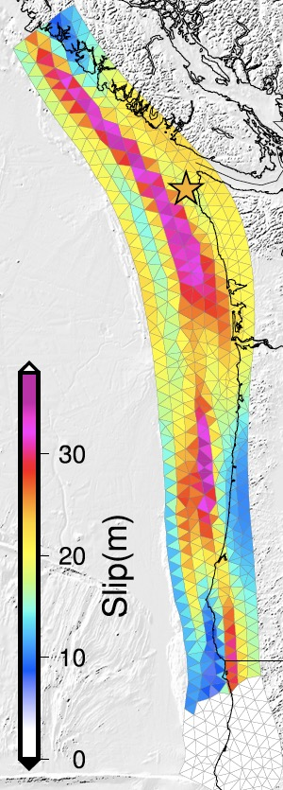
Hypothetical slip models
“The uncertainties of the inferred source parameters from paleoseismic studies are inherently large, and therefore, there is good reason to explore scenarios that challenge preconceptions of what is likely.”
—Melgar et al., 2016
Modeling conflicts with observations of repeated coastal subsidence.
Advances in Cascadia science must leverage convergences between modeling and observations.
Pacific Northwest Earthquake Science Workshop
5 November 2019
Melgar et al., 2016
Notes:
As numerical models simulating earthquakes get ever more sophisticated, a broader range of scenarios may be explored. There is good reason to explore scenarios that challenge preconceptions!
However, some models diverge from observations and may be unrealistic, like this model with stochastic slip exceeding 20-30 m that extends below the southern Oregon coast. This model predicts several meters of uplift in southern Oregon, which has not been observed.
Advances in Cascadia science must leverage convergences between modeling and observations.
It is difficult to reconcile models like this with 6000-7000 yr long records of repeated widespread coastal subsidence during past megathrust earthquakes. Although coastal observations may not rule out a scenario like this, they certainly suggest that such an event has a low probability.

Slide 29
Concluding remarks
Advancing Cascadia science will require consilience
- Cascadia earthquake recurrence intervals vary along strike
- Offshore and onshore data indicate shorter recurrence intervals
in northern and southern Cascadia
- Models of fault slip are not unique but they must fit observations
- USGS Powell Center Working Group on Cascadia Recurrence
DOWN
UP
Pacific Northwest Earthquake Science Workshop
5 November 2019

Slide 30
Concluding remarks
New opportunities to leverage consilience
- Seek more precise dates for earlier Cascadia earthquakes
- Model slip with constraints from subsidence and tsunami data
- Estimate shaking from landslide and liquefaction data
- Conduct new research on lake paleoseismology
DOWN
UP
Pacific Northwest Earthquake Science Workshop
5 November 2019

Slide 31
Thank you!
Salmon River estuary, Oregon
Photo by Rob Witter
Pacific Northwest Earthquake Science Workshop
University of Washington, Seattle, WA
Tuesday, 5 November 2019
Robert C. Witter, PhD
USGS Research Geologist
rwitter@usgs.gov
Pacific Northwest Earthquake Science Workshop
5 November 2019

Slide 32
Fault geometry matters
Purpose: define tsunami sources for northern Cascadia
- Tested three fault geometries
a) Buried rupture
b) Splay fault
c) Trench-breaching / frontal
thrust
Splay fault
Gao et al., 2018
Pacific Northwest Earthquake Science Workshop
Notes:
The last slip model I’ll show is recent work by Dawei Gao and colleagues. The purpose of the project was to define tsunami sources for northern Cascadia. They tested three fault geometries: a) a buried rupture that tapered slip to zero at the trench; b) a splay fault model that diverts about 20 m of slip to a shallow thrust fault that breaks the seafloor (shown in figure a at right; corresponding deformation is shown in b); and c) a trench-breaching rupture where slip continues to the trench and breaks the surface along a hypothetical frontal thrust, shown in the next slide...

Slide 33
Breaching the trench
The splay fault scenario generates the largest tsunami
Buried fault
Splay fault
Trench-breaching
Pacific Northwest Earthquake Science Workshop
5 November 2019
Gao et al., 2018
Notes:
The trench-breaching scenario is shown in the upper right maps. Tests of the trench-breaching scenario distribute as much as 50% to the full 100% of slip to a frontal thrust, again about 20 m full slip. Seafloor deformation produces a large uplift along the frontal thrust, but landward uplift is less compared to the splay fault model. As a result of this trade off, the trench breaching scenario generates a smaller tsunami than the splay fault geometry. The maximum modeled tsunami heights after 10 hrs for the three different source geometries are shown in the lower maps, which clearly show the higher splay fault tsunami in dark red.

